Slide 1

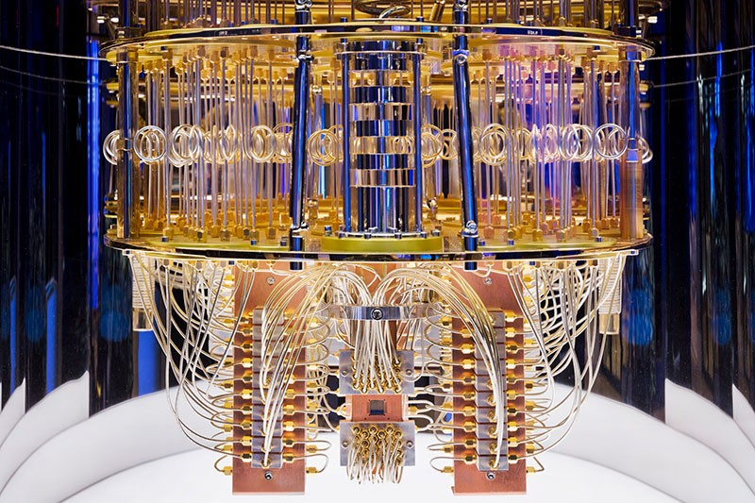
Quantum Optimization
Edward Hall
2nd Year Physics
Lecture 1/4:
Introduction to Quantum Optimization

Slide 2
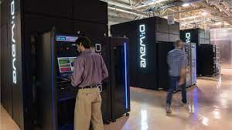
Learning outcomes:
Lecture 1:
What is Quantum Optimization.
How quantum computers can be used for Portfolio Optimization.
Lecture 2:
Three main methods used for Portfolio Optimization:
Quantum Annealing.
Quantum Approximate Optimization Algorithm (QAOA).
Variational Quantum Eigensolver (VQE).
Lecture 3:
Three main applications:
Optimal Trading Trajectory.
Optimal Arbitrage Opportunities.
Optimal Feature Selection in Credit Scoring.
Lecture 4:
Conclusion

Slide 3


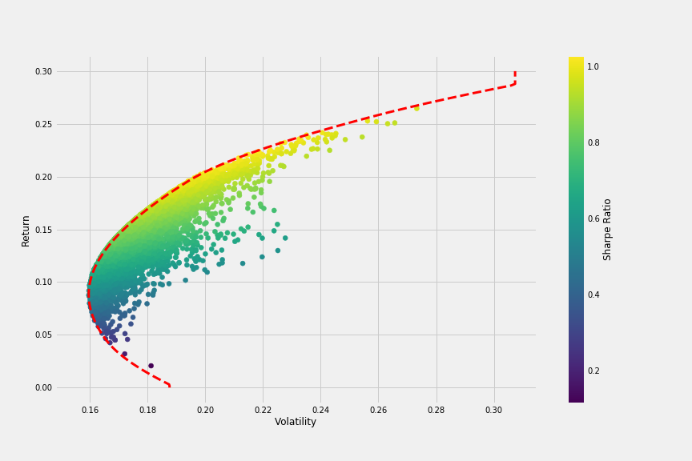
What is optimization?
Optimization definition:
The maximization of financial objectives, through allocating resources in the most efficient way.
Financial objectives:
Net profit
Expense reduction
Portfolio optimization:
The selection of a group of investments, which had the highest returns for a given risk.
Considered an ‘NP hard problem’

Slide 4

Quantum Optimization
Edward Hall
2nd Year Physics
Lecture 2/4:
Three methods of Quantum Optimization

Slide 5
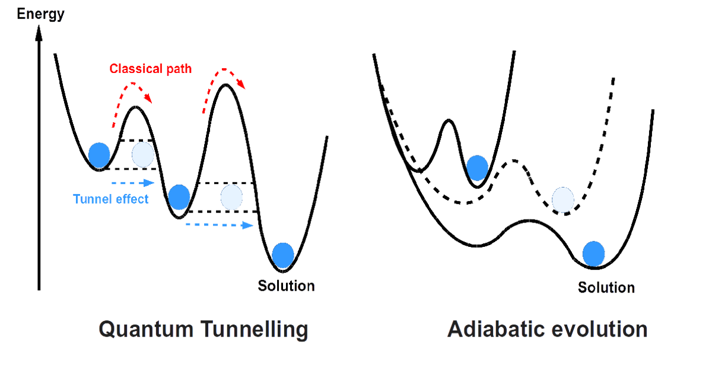
Quantum Optimization Methods
Three methods of quantum optimization:
Quantum annealing.
Quantum Approximate Optimization Algorithm (QAOA).
Variational Quantum Eigensolver (VQE).
We will first need to understand the Hamiltonian concept.

Slide 6
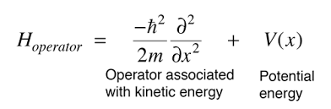
Key concept: Hamiltonians (1)
Hamiltonian definition: an operator that describes the sum of kinetic and potential energies of a system.
Operator:
Most simple example of an operator: Addition or Subtraction.
In this case, this results in a function being produced from another function;
The Hamiltonian operator:

Slide 7
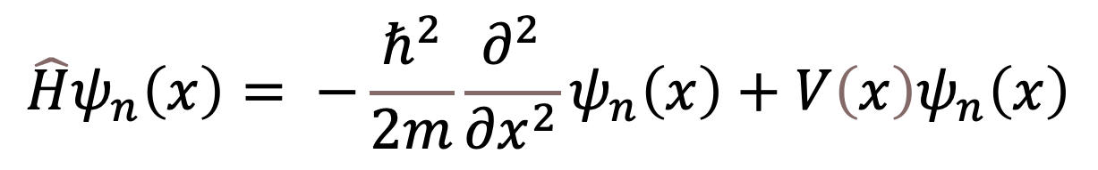
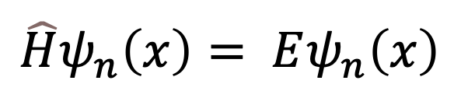
Key concept: Hamiltonians (2)
When our Hamiltonian Operator is applied to a wave function:
We get our (time independent) Schrödinger equation!
Most importantly:
The above equation has multiple solutions.
At each energy level a particle is at, there are many states that correspond to it (degeneracy).
Mathematically, this is represented with the Hamiltonian above.
$$\hat{H}ψ_{n}\left(x\right)= −\frac{ℏ^{2}}{2m}\frac{∂^{2}}{∂x^{2}}ψ_{n}\left(x\right)+V\left(x\right)ψ_{n}\left(x\right)$$
$$\hat{H}ψ_{n}\left(x\right)= Eψ_{n}\left(x\right)$$

Slide 8
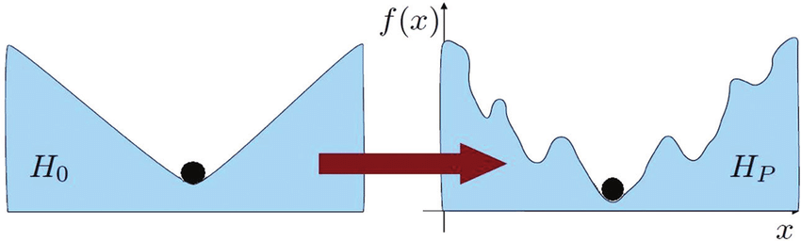
Quantum Annealing (1)
The first, and most famous implementation of (adiabatic) quantum computation is quantum annealing.
Over a long period, T, H₀ is adiabatically deformed to H_{P} . While keeping the energy levels of the Hamiltonians separate, we are likely to be left in the ground state of the Hamiltonian (known as the ’universal model of quantum computation’).
H₀ – Our starting Hamiltonian value.
H_{p} - The cost function we want to minimize through optimization.

Slide 9
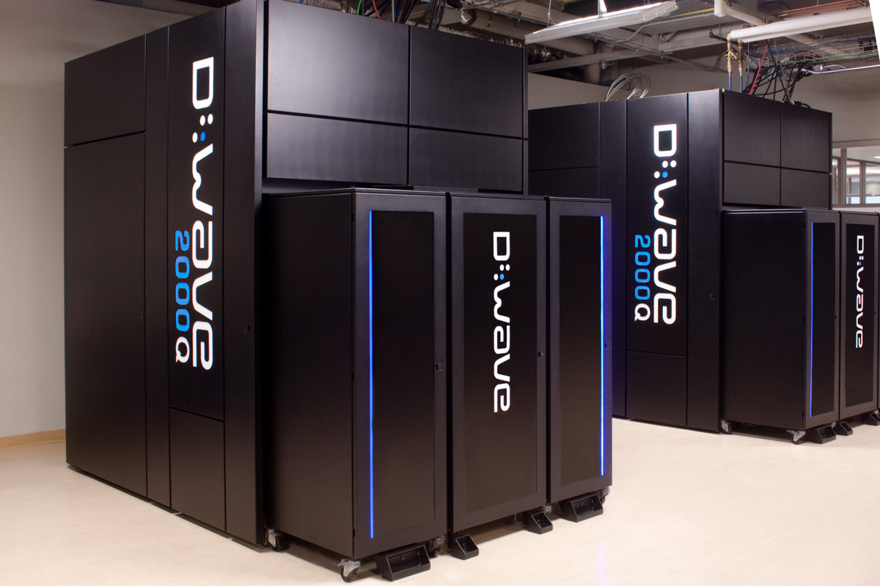
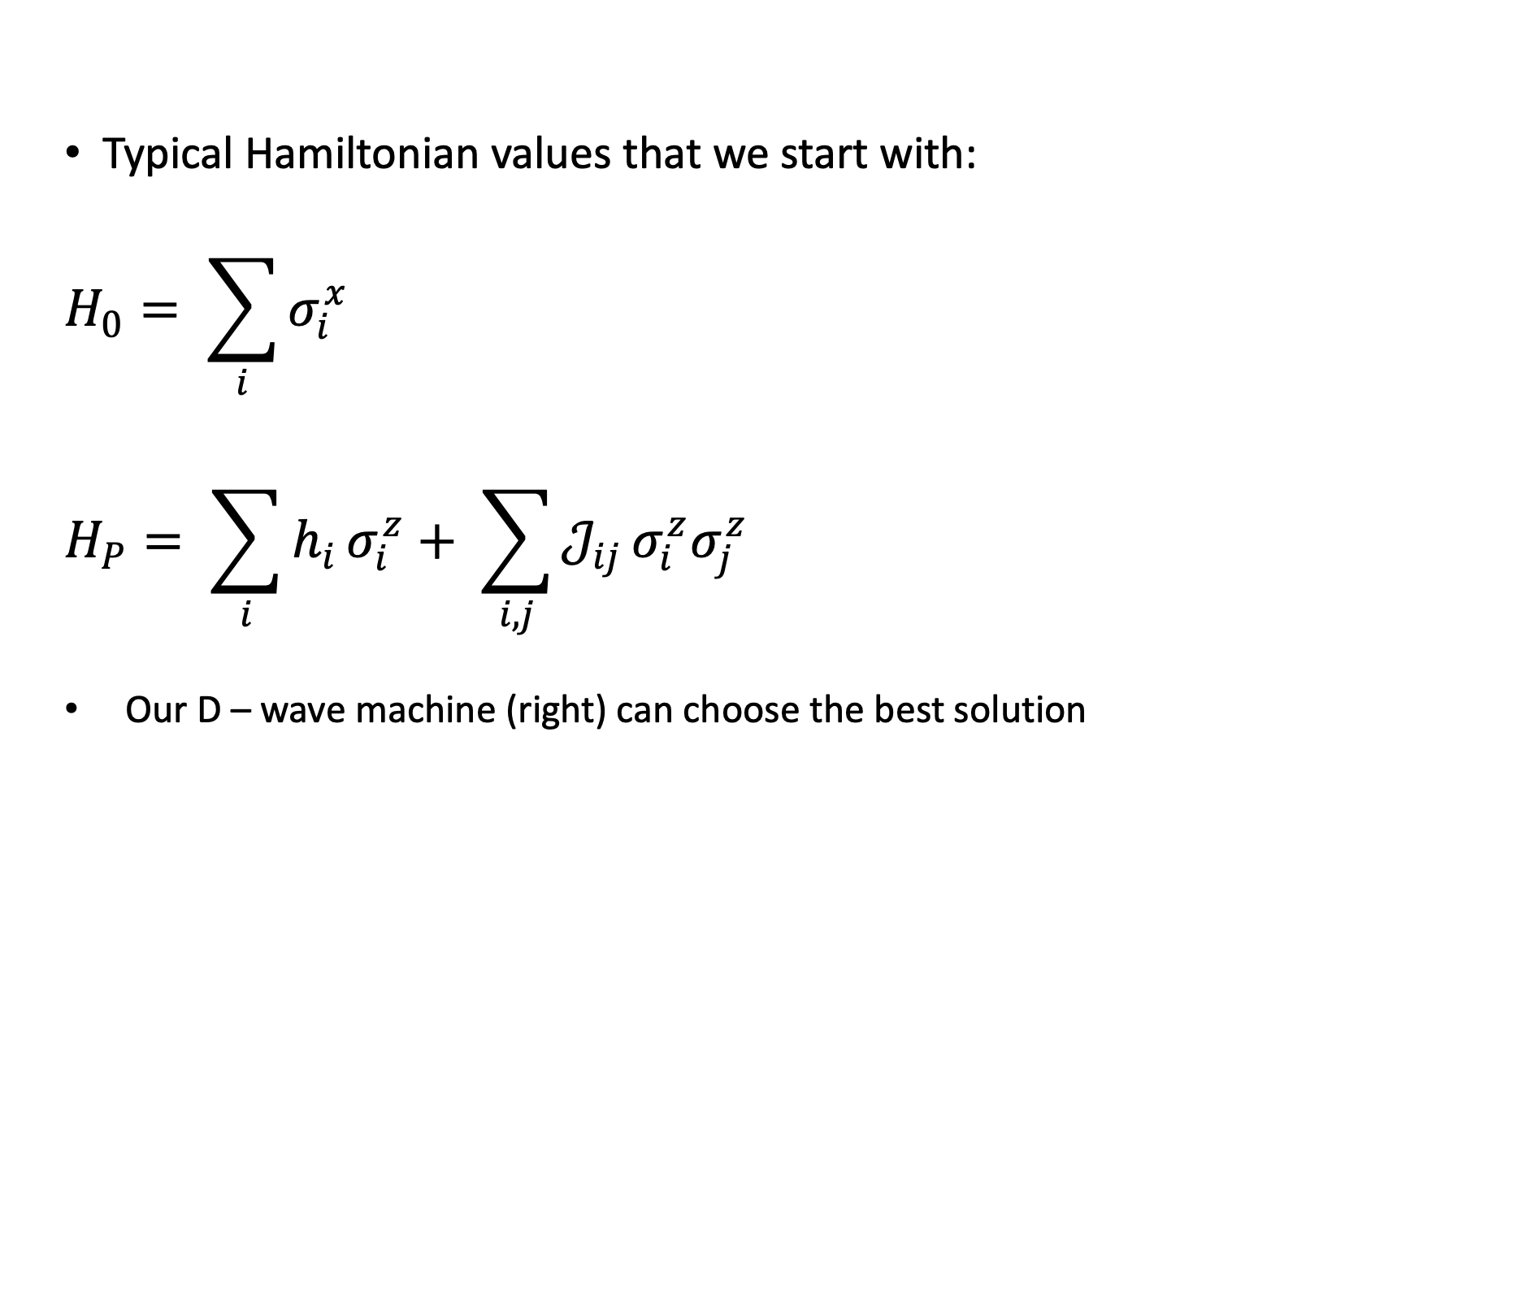
Quantum Annealing (2)
Typical Hamiltonian values that we start with:
$$H_{0}= \sum_{i}{σ_{i}^{x}}$$
$$H_{P}= \sum_{i}{h_{i}}σ_{i}^{z}+ \sum_{i, j}{𝒥_{ij}}σ_{i}^{z}σ_{j}^{z}$$
Our D – wave machine (right) can choose the best solution

Slide 10
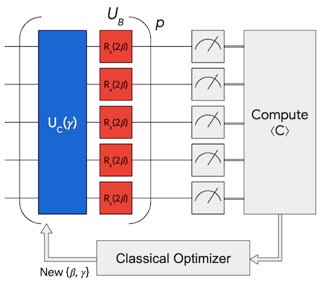

Quantum Approximate Optimization Algorithm (QAOA) (1)
QAOA is very similar to adiabatic quantum computing!
Only difference: the adiabatic evolution is broken up into discrete steps.
Mathematically, the process is represented as:
$$U\left(t\right) → \prod_{i=1}^{m}{e^{−iH_{0}α_{i}}e^{−iH_{P}β_{i}}}$$

Slide 11
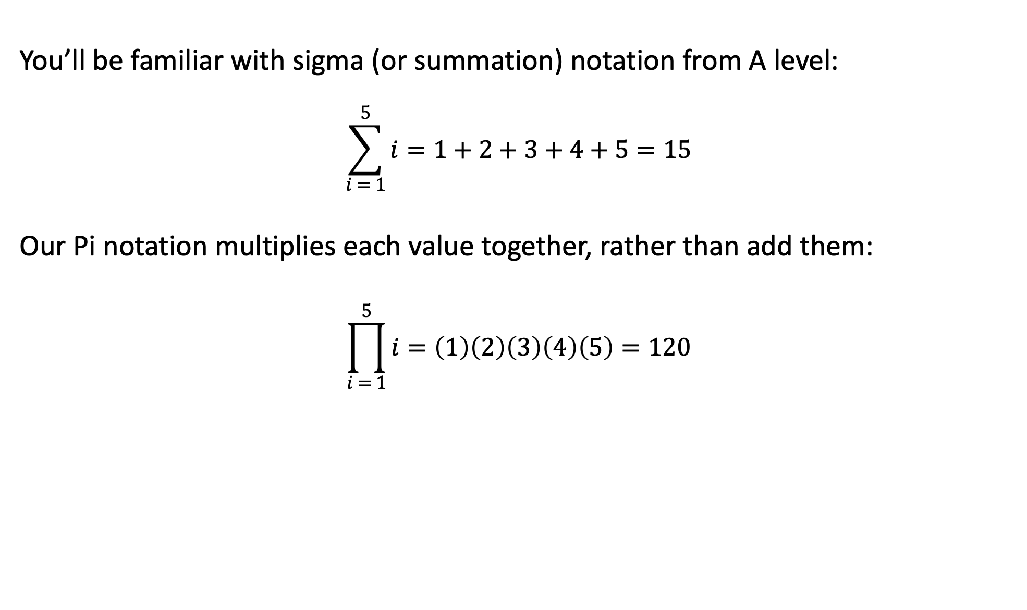
‘Pi Notation’
You’ll be familiar with sigma (or summation) notation from A level:
$$\sum_{i = 1}^{5}{i}=1+2+3+4+5=15$$
Our Pi notation multiplies each value together, rather than add them:
$$\prod_{i = 1}^{5}{i}=\left(1\right)\left(2\right)\left(3\right)\left(4\right)\left(5\right)=120$$

Slide 12
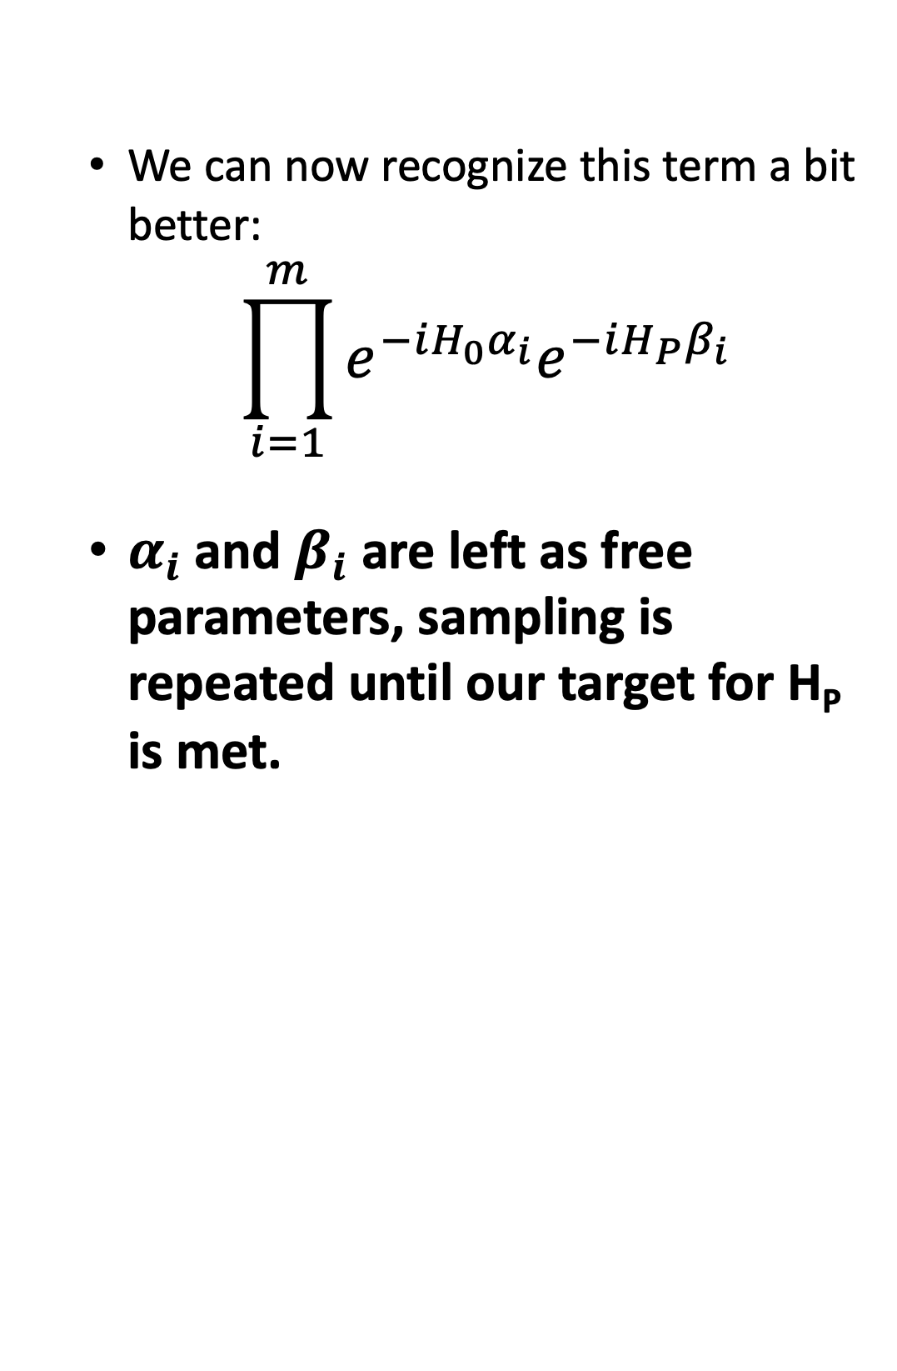
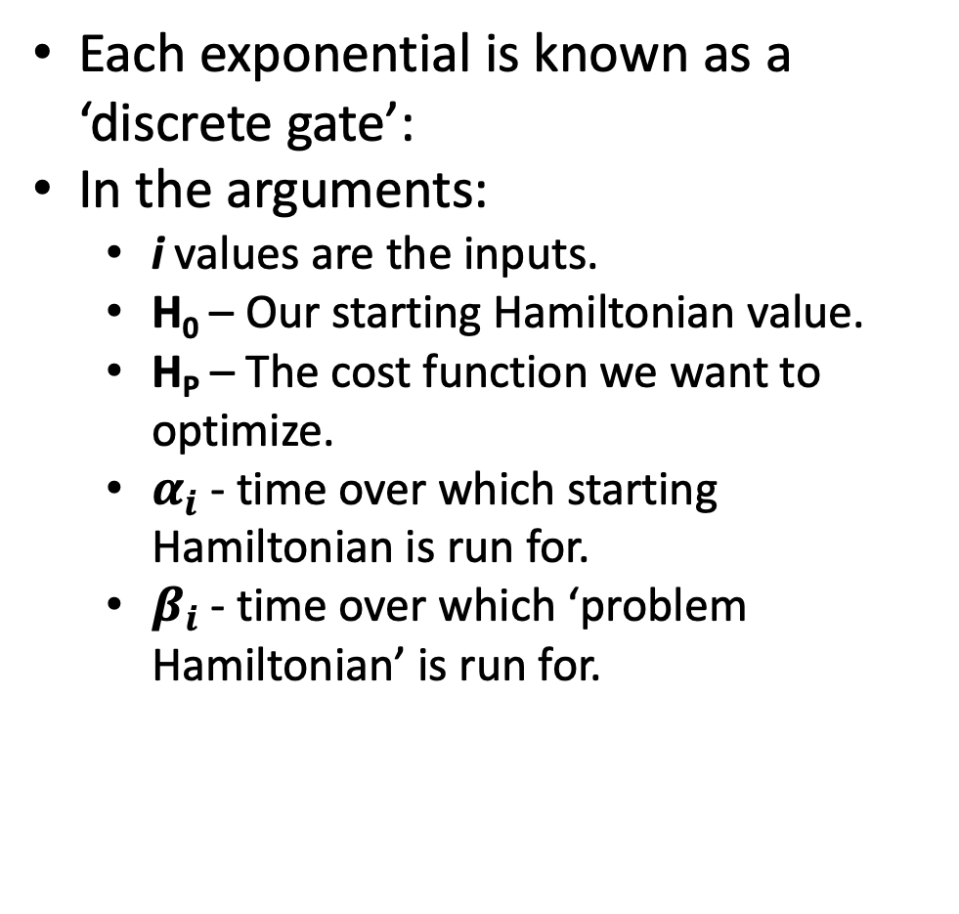
Quantum Approximate Optimization Algorithm (QAOA) (2)
We can now recognize this term a bit better:
$$\prod_{i=1}^{m}{e^{−iH_{0}α_{i}}e^{−iH_{P}β_{i}}}$$
$α_{i}$ and $β_{i}$ are left as free parameters, sampling is repeated until our target for H_{P} is met.
Each exponential is known as a ‘discrete gate’:
In the arguments:
i values are the inputs.
H₀ – Our starting Hamiltonian value.
H_{P} – The cost function we want to optimize.
$α_{i}$ - time over which starting Hamiltonian is run for.
$β_{i}$ - time over which ‘problem Hamiltonian’ is run for.

Slide 13
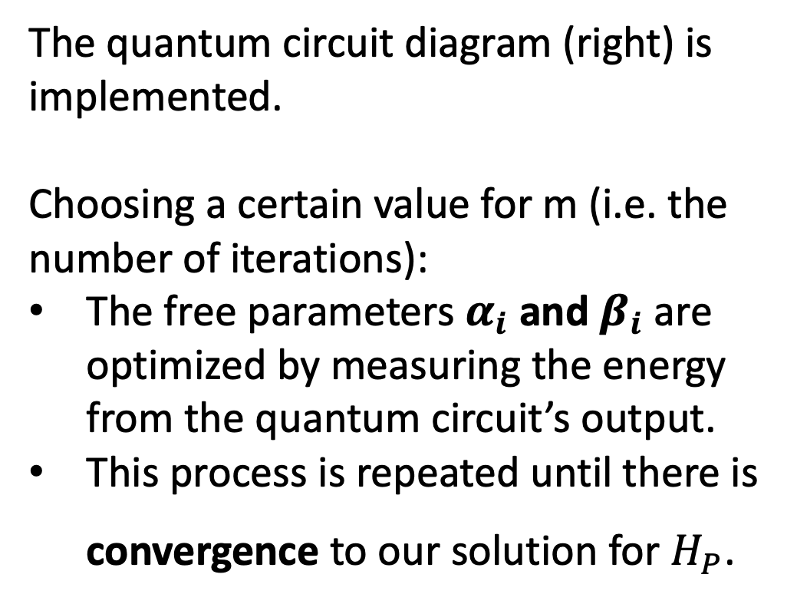
Quantum Approximate Optimization Algorithm (QAOA) (3)
The quantum circuit diagram (right) is implemented.
Choosing a certain value for m (i.e. the number of iterations):
The free parameters $α_{i}$ and $β_{i}$ are optimized by measuring the energy from the quantum circuit’s output.
This process is repeated until there is convergence to our solution for $H_{P}$.

Slide 14
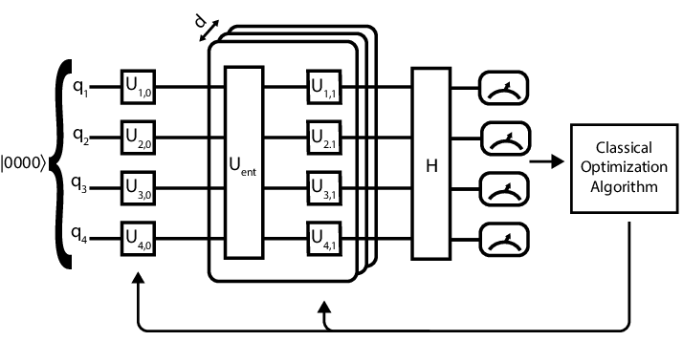
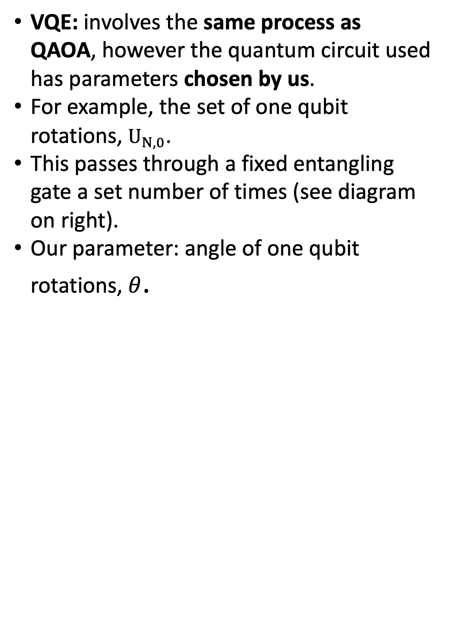
Variational Quantum Eigensolver (VQE)
VQE: involves the same process as QAOA, however the quantum circuit used has parameters chosen by us.
For example, the set of one qubit rotations, $U_{N,0}$.
This passes through a fixed entangling gate a set number of times (see diagram on right).
Our parameter: angle of one qubit rotations, $θ$.

Slide 15
Summary
Three main methods used for Portfolio Optimization:
Quantum Annealing.
Quantum Approximate Optimization Algorithm (QAOA).
Variational Quantum Eigensolver (VQE).

Slide 16

Quantum Optimization
Edward Hall
2nd Year Physics
Lecture 3/4:
Three applications of Quantum Optimization

Slide 17
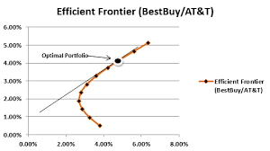
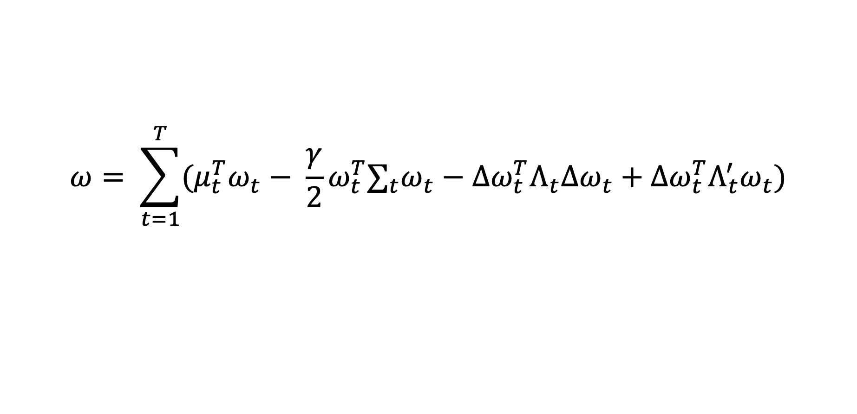
Optimal trading trajectory (1)
More famously known as Dynamic Portfolio Optimization.
Finds the portfolio that will provide the best outcome, while considering transaction costs and market impact.
Works with Quantum Annealing, QAOA and VQE!
Over a long period of time, the portfolio with the best outcome is found every day, until it’s returns are maximized.
$$ω= \sum_{t=1}^{T}{(μ_{t}^{T}ω_{t}− \frac{γ}{2}ω_{t}^{T}∑_{t}ω_{t}−∆ω_{t}^{T}Λ_{t}Δω_{t}+Δω_{t}^{T}Λ_{t}^{′}ω_{t})}$$

Slide 18
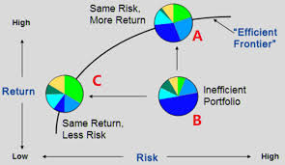
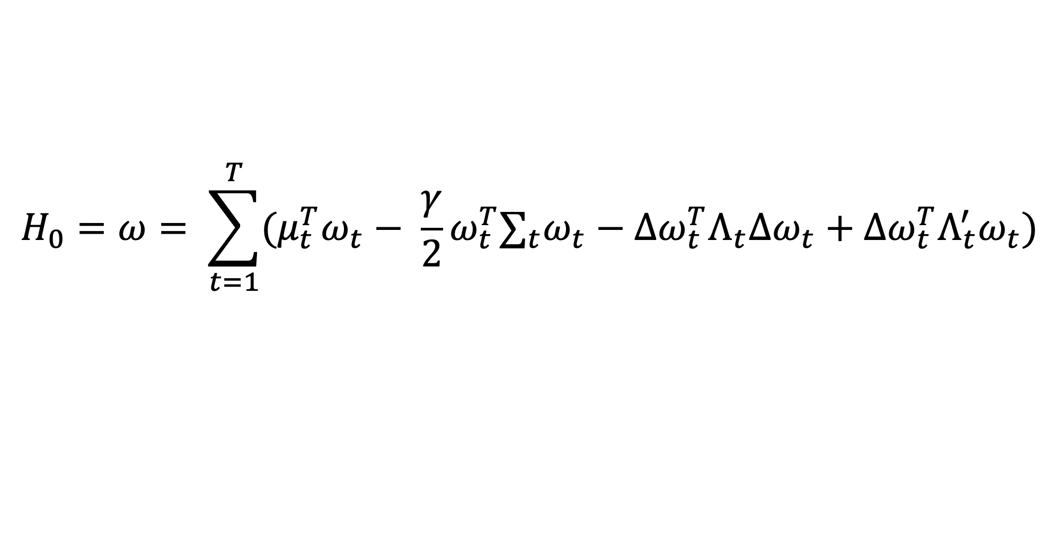
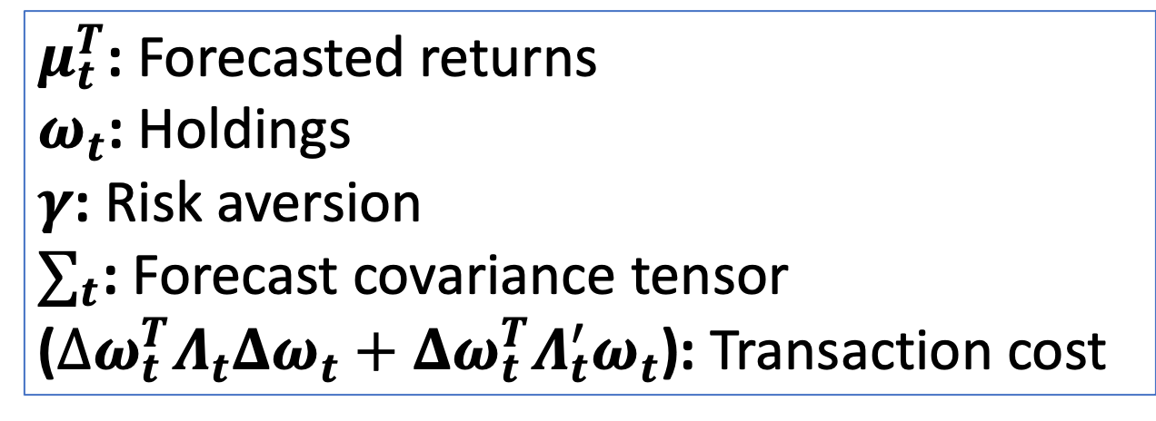
Optimal trading trajectory (2)
$$H_{0}=ω= \sum_{t=1}^{T}{(μ_{t}^{T}ω_{t}− \frac{γ}{2}ω_{t}^{T}∑_{t}ω_{t}−∆ω_{t}^{T}Λ_{t}Δω_{t}+Δω_{t}^{T}Λ_{t}^{′}ω_{t})}$$
Key Terms:
$μ_{t}^{T}$: Forecasted returns
$ω_{t}$: Holdings
$γ$: Risk aversion
$∑_{t}$: Forecast covariance tensor
($∆ω_{t}^{T}Λ_{t}Δω_{t}+Δω_{t}^{T}Λ_{t}^{′}ω_{t}$): Transaction cost

Slide 19
Optimal trading trajectory (3)
Expected return
Standard deviation

Slide 20
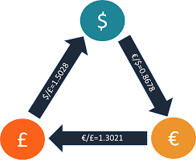
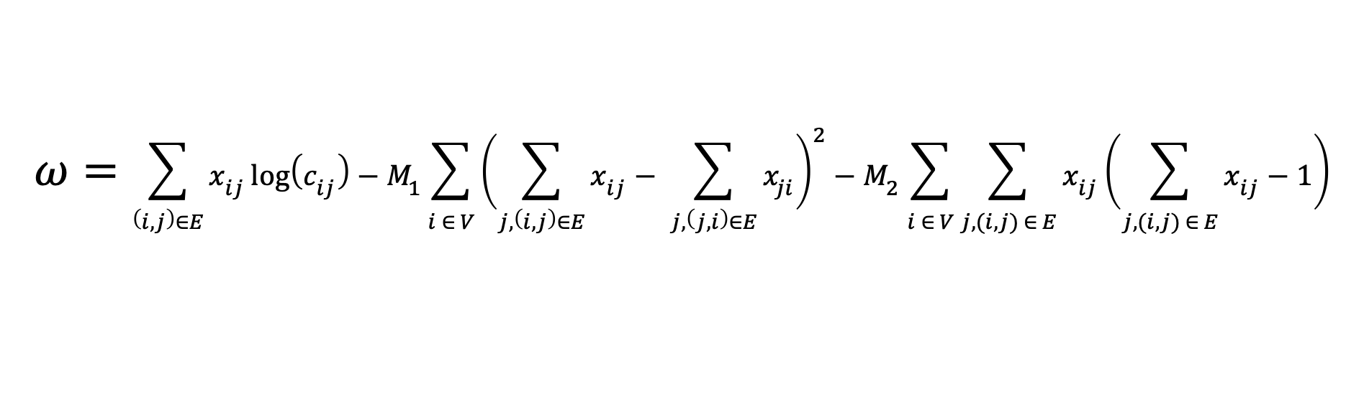
Optimal arbitrage opportunities (1)
Arbitrage: making profit through different prices in the same asset in different markets.
Very powerful when applied in currency trading, also known as FOREX trading.
$$ω=\sum_{\left(i, j\right)∈E}{x_{ij}\log\left(c_{ij}\right)−M_{1}\sum_{i ∈ V}{{\left(\sum_{j,\left(i,j\right)∈E}{x_{ij}}− \sum_{j,\left(j,i\right)∈E}{x_{ji}}\right)}^{2}}}{− M}_{2}\sum_{i ∈ V}{\sum_{j,(i,j) ∈ E}{x_{ij}}}\left(\sum_{j,(i,j) ∈ E}{x_{ij}−1}\right)$$

Slide 21
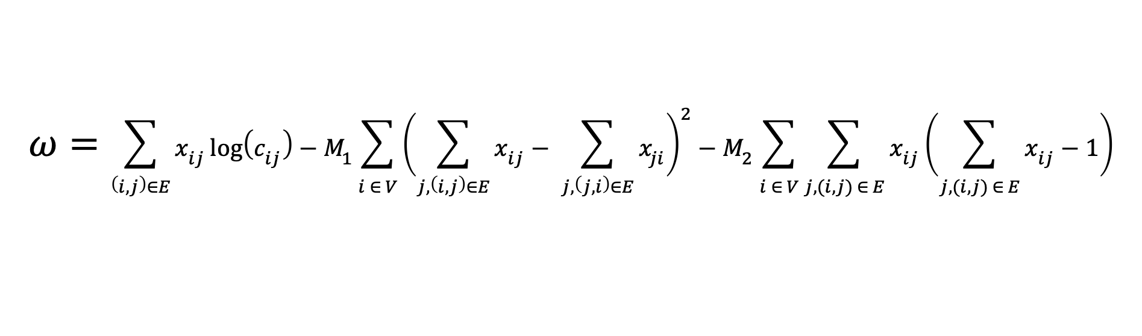
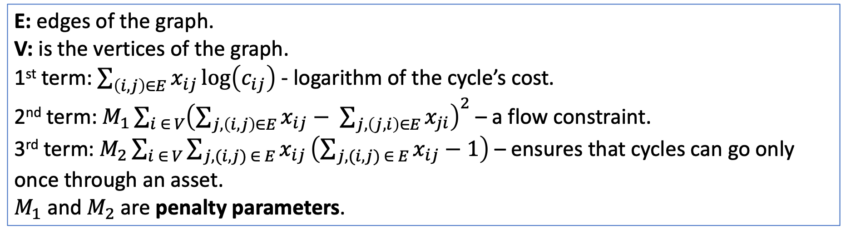
Optimal arbitrage opportunities (2)
$$ω=\sum_{\left(i, j\right)∈E}{x_{ij}\log\left(c_{ij}\right)−M_{1}\sum_{i ∈ V}{{\left(\sum_{j,\left(i,j\right)∈E}{x_{ij}}− \sum_{j,\left(j,i\right)∈E}{x_{ji}}\right)}^{2}}}{− M}_{2}\sum_{i ∈ V}{\sum_{j,(i,j) ∈ E}{x_{ij}}}\left(\sum_{j,(i,j) ∈ E}{x_{ij}−1}\right)$$
E: edges of the graph.
V: is the vertices of the graph.
1st term: $\sum_{\left(i, j\right)∈E}{x_{ij}}\log\left(c_{ij}\right)$ - logarithm of the cycle’s cost.
2nd term: $M_{1}\sum_{i ∈ V}{{\left(\sum_{j,\left(i,j\right)∈E}{x_{ij}}− \sum_{j,\left(j,i\right)∈E}{x_{ji}}\right)}^{2}}$ – a flow constraint.
3rd term: $M_{2}\sum_{i ∈ V}{\sum_{j,(i,j) ∈ E}{x_{ij}}}\left(\sum_{j,(i,j) ∈ E}{x_{ij}−1}\right)$ – ensures that cycles can go only once through an asset.
$M_{1}$ and $M_{2}$ are penalty parameters.

Slide 22
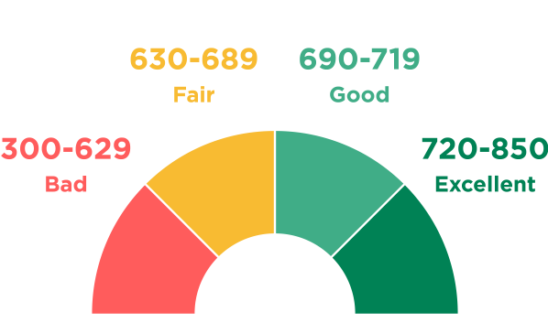
Optimal feature selection in credit scoring (1)
Credit scoring: Identifying of the level of risk that is associated with a loan, by considering factors like the borrower’s income, age, etc.
Enables banks to find the ‘creditworthiness’ of a potential borrower.

Slide 23
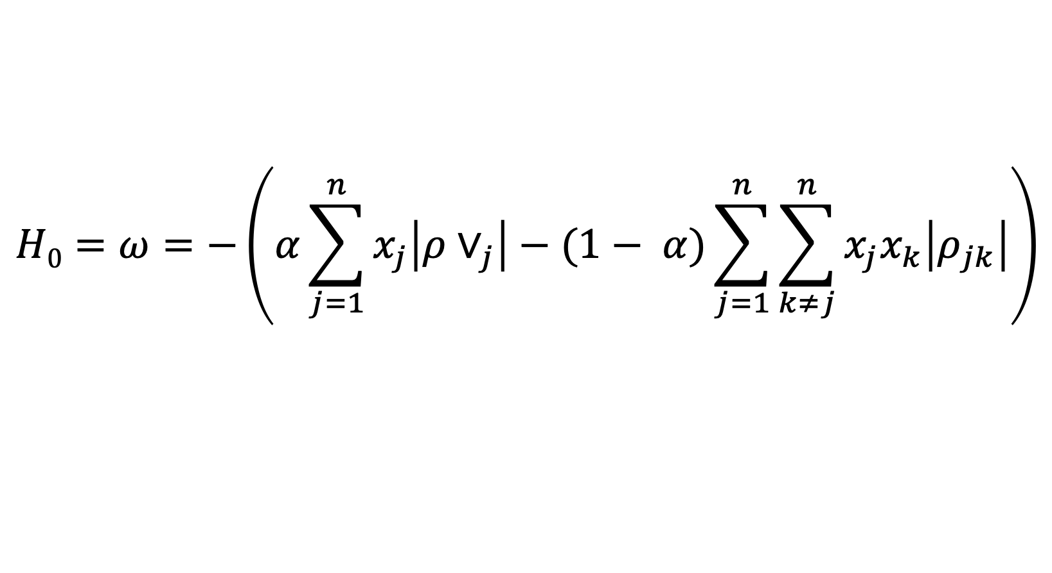
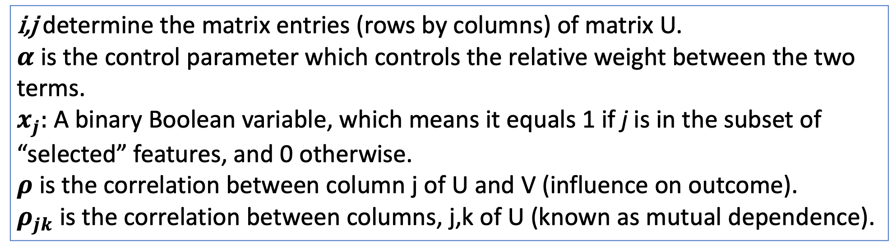
Optimal feature selection in credit scoring (2)
$$H0=ω=−\left(α\sum_{j=1}^{n}{x_{j}\left|ρ∨_{j}\right|−(1− α)}\sum_{j=1}^{n}{\sum_{k≠j}^{n}{x_{j}x_{k}\left|ρ_{jk}\right|}}\right)$$
i,j determine the matrix entries (rows by columns) of matrix U.
$α$ is the control parameter which controls the relative weight between the two terms.
$x_{j}:$ A binary Boolean variable, which means it equals 1 if j is in the subset of “selected” features, and 0 otherwise.
$ρ$ is the correlation between column j of U and V (influence on outcome).
$ρ_{jk}$ is the correlation between columns, j,k of U (known as mutual dependence).

Slide 24
Quantum Optimization
Edward Hall
2nd Year Physics
Lecture 4/4:
Summary

Slide 25
Overall Summary
What is Quantum Optimization.
How quantum computers can be used for Portfolio Optimization.
Three main methods used for Portfolio Optimization:
Quantum Annealing.
Quantum Approximate Optimization Algorithm (QAOA).
Variational Quantum Eigensolver (VQE).
Three main applications:
Optimal Trading Trajectory.
Optimal arbitrage opportunities.
Optimal feature selection in credit scoring.

Slide 26
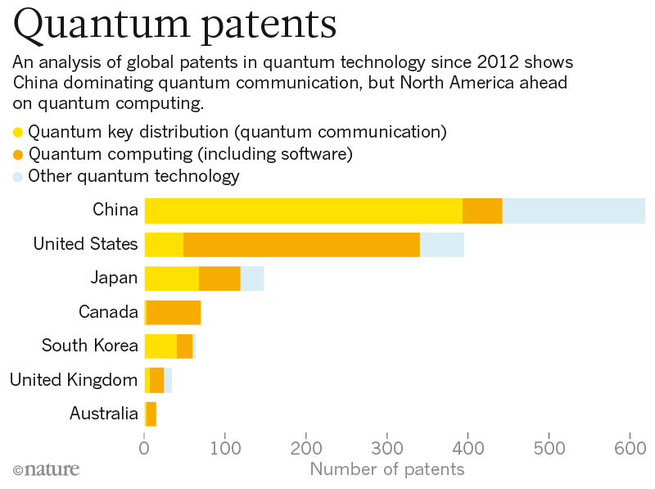
Conclusions

